Slide 1
Identification of Quora question pairs with same intent
Group 9
Goutham Reddy
Nitin Garg
Sneh Lata
Sourav Bose

Slide 2
Quora Question Pairs (QQP)
Objective
Build a question similarity classifier to detect duplicate questions
Why is this problem important?
Growth in community based question answering such as Quora, Reddit etc. As number of questions grow, so do the duplicates
Treating duplicate questions independently will restrict presenting high quality responses to the users
Reduces answering burden for the responders, thereby improving overall user experience
Improving user experience
Extension of these models @ work
IT companies have a huge compendium of problems and their solutions. Many of these problems are duplicate. Application of these models will help in presenting coherent set of solutions to the users, thereby helping in cross deployment of knowledge

Slide 3
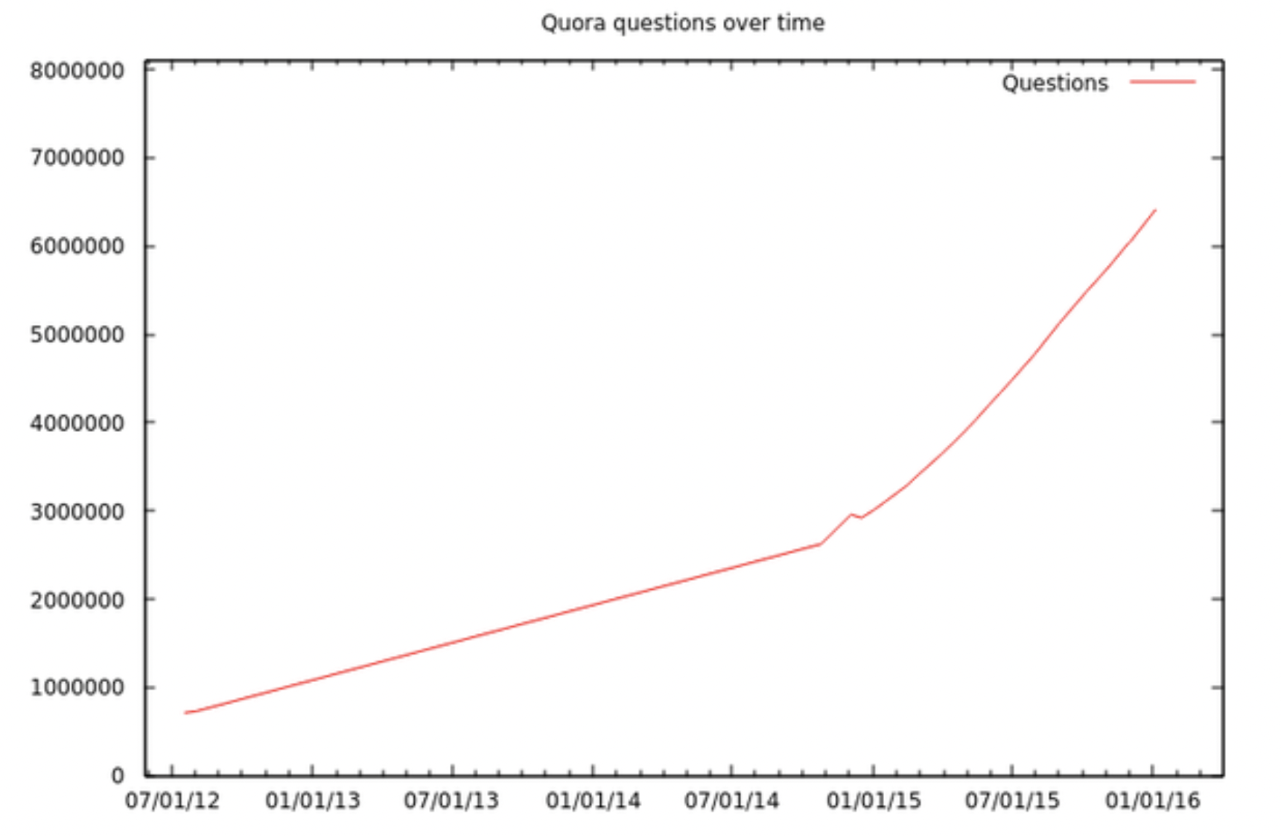
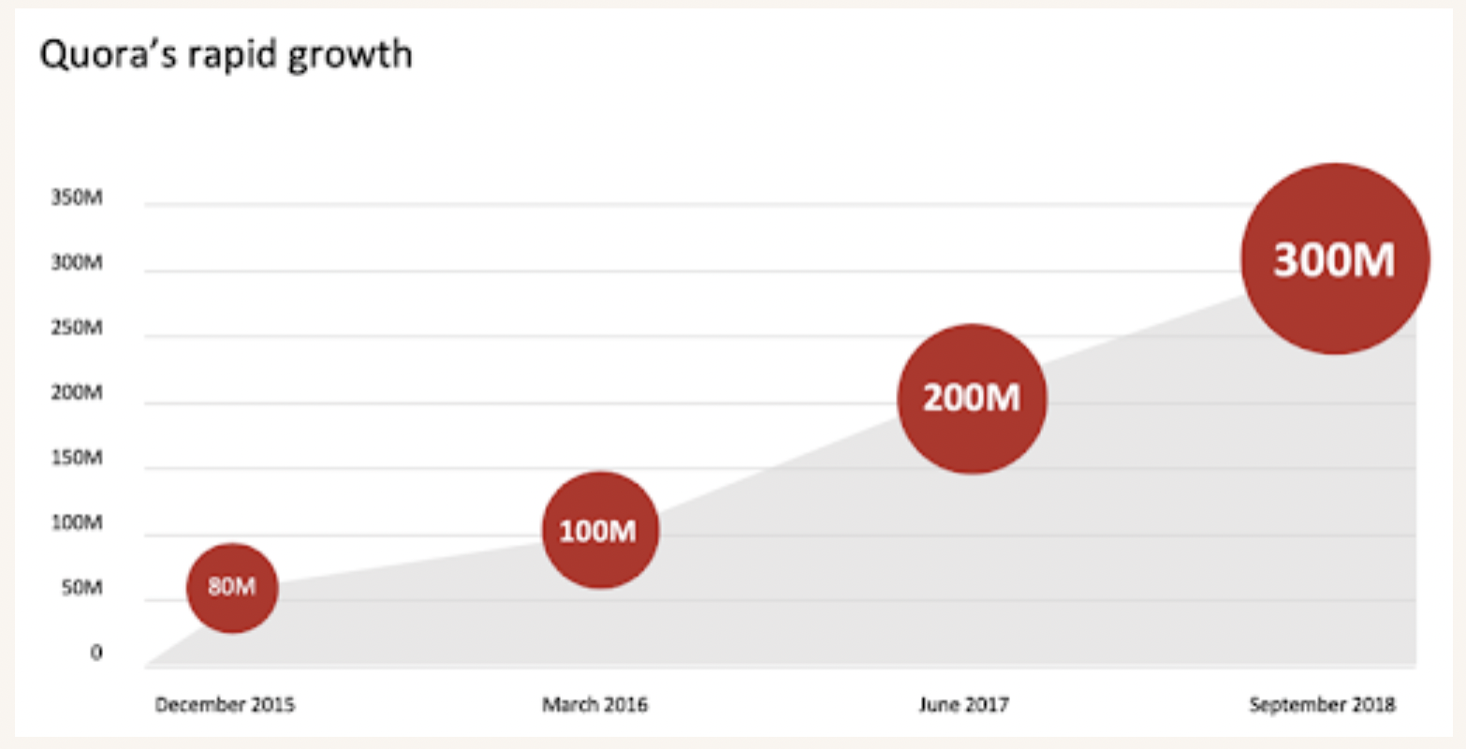
About Quora
Quora Statistics
Question Statistics
Quora has 300+ million monthly active users
The majority of Quora users are from 18 to 24
The average time spent by a user on the platform is around 8-10 minutes
3000 to 5000 Questions are asked on the platform every day
As of 2021, Quora gets an average of 3,000 – 5,000 questions daily
99% of questions asked on Quora get answered
20% of questions get not less than 3 answers
90% of questions on Quora have less than ten answers
Over 30% of Quora users haven’t responded to any question

Slide 4
Benchmarks & Approach
Quora question pair problem has been extensively researched and is part of the GLUE benchmarks under similarity and paraphrase type of NLP tasks
GLUE Benchmark¹: Accuracy → 86.5; F1Score → 66.1 with BiLSTM Model + Attn + ELMO
Current Benchmark: Accuracy → 92.3% with XLNet
Benchmarks
Classical ML models such as Logistic regression, Support Vector Machines, Random Forest, XG Boost, LGBM, Voting Classifier and iteratively improving accuracy scores through feature engineering and data cleaning methods
Applying deep neural networks such as C-BOW, sentence BERT
Deep dive on edge cases, identify areas for further improving the accuracy of the models
Approach:
1. pdf (openreview.net)
2. Quora Question Pairs Benchmark (Question Answering) | Papers With Code

Slide 5
Feature Engineering
Base Features
Derived Features
Embeddings & Distances
Length of question 1
Length of question 2
Same question type (what, why, when, where, how)
% Common words
POS features:
Fuzz Ratio
Fuzz Partial Ratio
Token Set Ratio
Average Fuzz Score
Ratio of common word count with word count (min/ max)
Ratio of common non-stop words to word count (min/ max)
Absolute length difference of question pair
Average lengths of the question pair
TFIDF based Weighting
Mean weights with GLOVE 100 Embeddings
Distances between two vectors
Cityblock distance
Canberra distance
Cosine distance
Euclidean distance
Sequence Ratio
'q1_verb_count'
'q2_verb_count'
'q1_noun_count'
'q2_noun_count'
'q1_adj_count'
'q2_adj_count'
'q1_adv_count'
'q2_adv_count'

Slide 6
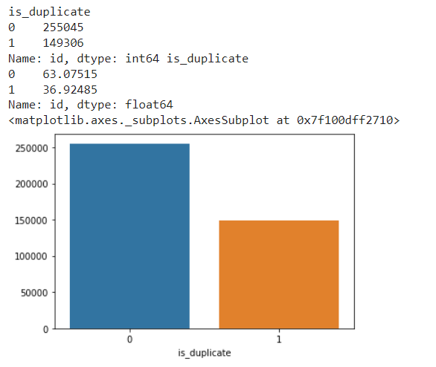
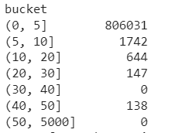
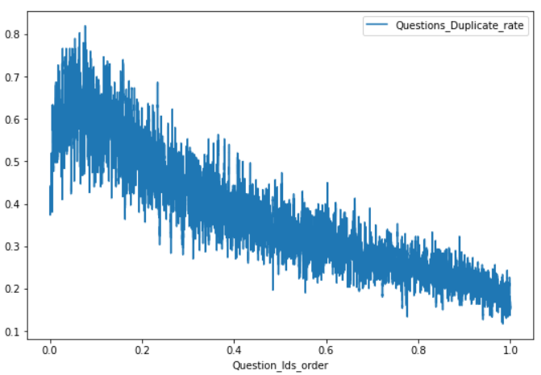
Exploratory Data Analysis
Data Distribution
Repetition of Questions
Temporal Nature
Decreasing trend of Quora Question duplicates as the Question Id increases
Train data is shuffled to overcome above issue and for better model learning
404351 training data points. No. of non-duplicate data points is 255045 and duplicate data points is 149306
36.92% of question pairs are duplicates and 63.08% of questions pair non-duplicate
Repetition of questions: 99.7% of the questions are repeated less than 5 times
138 questions are repeated more than 40 times

Slide 7
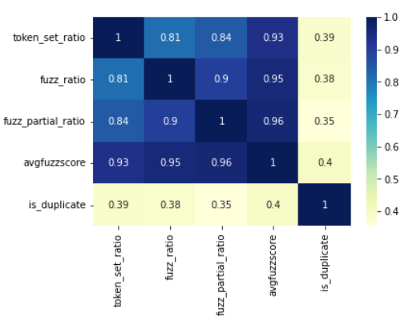
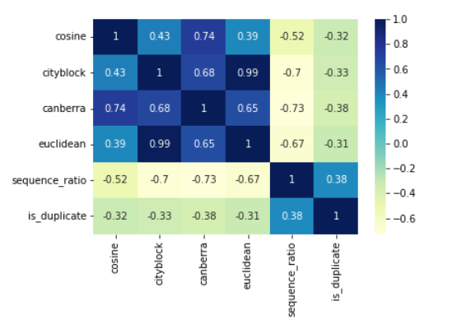
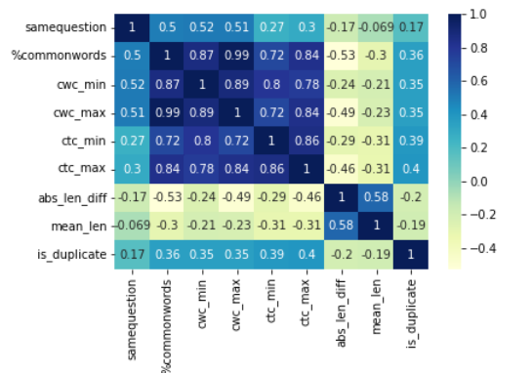
Exploratory Data Analysis
Base Features
Derived Features
Embeddings & Distances
Correlation of 0.35 to 0.4 observed between fuzzy features and the outcome metric
Negative correlation between distances and duplication of questions indicating smaller distance with higher probability of duplication
Sequence ratio and Canberra distances have highest correlation among these features
Non-Stop word ratio (CTC metrics), common word count ratios and % commonwords have high correlations with duplication of question

Slide 8
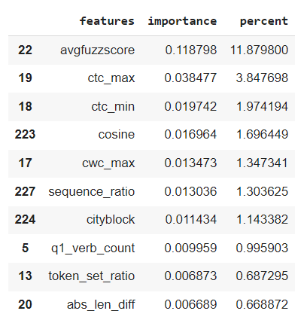
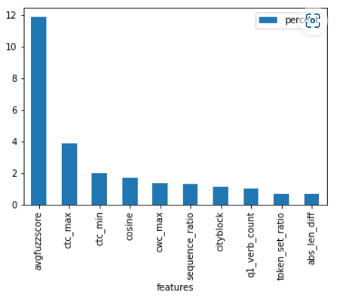
Feature Importance
Most impacting features are: Average Fuzz Ratio, Ratio of Non stop words with total words, Cosine and Cityblock distances, and Sequence Ratio

Slide 9
Edge Cases
Gage R&R/ Misclassifications
Observed question pairs that were identical in text, but were incorrectly classified as Not Duplicate
What are the differences between Github and Bitbucket?
What are the differences between BitBucket and GitHub?
Questions were marked as duplicate, but intent of the question was otherwise
What is the exercise to remove belly fat for girls?
How do I remove belly fat?
Changes in words but the intent remains the same
We observed that there were question pairs, wherein the second question was changed slightly by using synonyms or similar words. Its observed that LSTM based networks performed better in identifying duplication in such scenarios
What is the best gift for my boyfriend on Valentine's Day?
What are the Best Gifts for men on Valentine's day?

Slide 10
Edge Cases
Differing length of Questions
One question is small (in length) while second part is longer. However more text in one of the question changes the intent of the question hence they are not duplicates.
It is observed that much of these questions were identified correctly by LSTM and SBERT model than with XG boost model
What is the specific heat capacity of steam?
What is specific heat capacity?
One question is small (in length) while second part is longer. However more text in one of the question does not change the intent of the question hence they are duplicates.
We observed randomness in correctly identification of such question pairs by both the models.
What do you want to be remembered for?
What do you want to be remembered for when you die?
Impact of Numbers
Question pairs where numbers were involved and change intent of the question. We observe randomness in prediction by both the models
Is it safe to use castor oil at 36 weeks to induce labor?
Is it safe to use castor oil at 39 weeks to induce labor?

Slide 11
Results
Sr | Model Category | Model | Accuracy | F1-Score
1 | Classical ML Models | Logistic Regression | 70.5 | 66.7
2 |  | Linear SVM | 71.3 | 66.7
3 |  | Random Forest | TBD | TBD
4 |  | XG Boost | 83.7 | 76.5
5 |  | LGBM | 82.4 | 76
6 |  | Voting Classifier | TBD | TBD
7 | Neural Networks | C-BOW – Word2Vec | 81.47 | 74.5
8 |  | C-BOW – TFIDF-IDF weighted Word2Vec | 81 | 74.7
9 |  | LSTM – Word2Vec | 84.4 | 78.9
10 |  | LSTM – TFIDF-IDF weighted Word2Vec | 84 | 78.8
11 |  | Sentence BERT | 85.8 | 81

Slide 12
Conclusion
Best results were achieved through Sentence BERT modelling with 85.8% accuracy and 81% F1 Score.
Observed few question pairs that were identical in text, but were incorrectly classified as Not Duplicate
Observed few questions were marked as duplicate, but intent of the question was otherwise
Future work :
Stacking model could achieve further accuracy. We have created a stacking models but evaluation is in progress.

